Slide 1
Transformational Leadership:
Joel Robinson
joelhrobinson@gmail.com
PMI Lunch & Learn October 9 2019

Slide 2
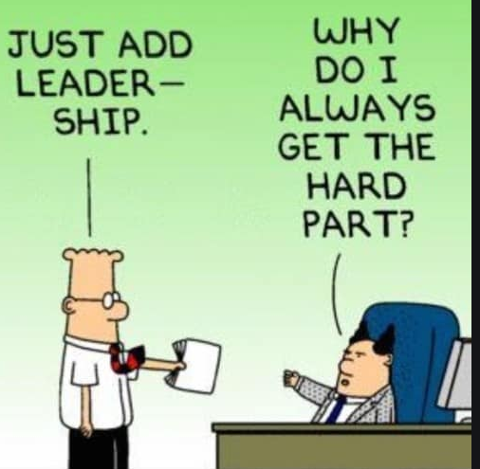

Slide 3

The Phoenix Project
By Gene Kim, Kevin Behr, George Spafford

Slide 4

Background Definitions

Slide 5
Change ➔Transformation
Change is a specific event, a calendar circle.
Change management is implementing finite initiatives (Harvard Business Review 2015/10)
Transition is a process we go through responding to a change… a constellation of thought, feeling and actions. Lee Chaix McDonough
Transformation is reinventing the organization with new or revised business models based on a vision of the future. (HBR 2015/10)

Slide 6
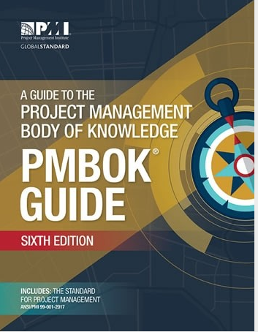
Project Management Body of Knowledge ver. 6
One sentence for term in
756 pages. (Next rev. 2023)
PMP exam changes July 1st next year. “About half of the [2020] examination will represent predictive project management approaches and the other half will represent agile or hybrid approaches.”

Slide 7
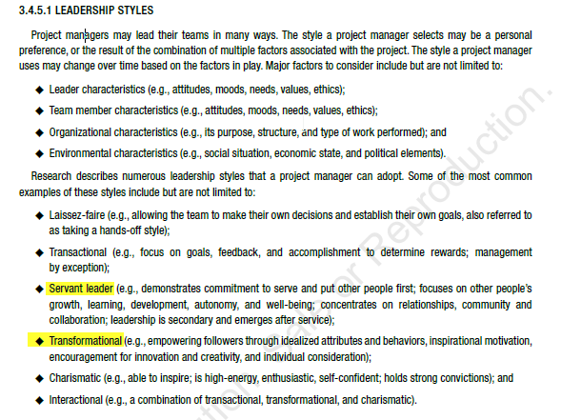

Slide 8
Transformational
PMBOK: 6th edition Section 3.4.5.1 Leadership Styles
Transformational: empowering followers through idealized attributes and behaviors, inspirational motivation, encouragement for innovation and creativity, and individual consideration.

Slide 9
What it’s Not

Slide 10
Not Servant Leader
PMBOK: 6th edition Section 3.4.5.1 Leadership Styles p.65
Servant Leader: commitment to serve and put other people first, focuses on employee growth, learning, development, autonomy, and well being;
Concentrates on relationships, community, collaboration; Leadership is secondary, emerges after service.

Slide 11

Not Transactional Leadership
PMBOK: 6th edition Section 3.4.5.1 Leadership Styles
…focuses on goals, feedback, and accomplishment in order to reward or manage by exception.

Slide 12

Not Predictive Manager Linear planning, specific structure around a pre-determined end result within a specific timeframe.

Slide 13
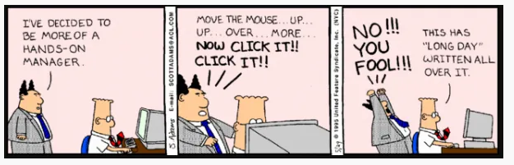
Not Hands On Manager

Slide 14
Transformational Leaders: Who are these people?

Slide 15
Transformational Leaders
Google
Jesus Christ Martin Luther King Jr.
Walt Disney George Washington
Nelson Mandela Howard Schultz
Ray Kroc Sam Walton
(Harvard Business Review)
Steve Jobs (Apple) Bill Gates (Microsoft)
Reed Hastings (Netflix) Jeff Bezos (Amazon)

Slide 16
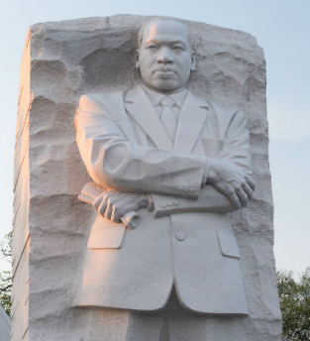
Martin Luther King Jr.
Leadership Style:
Empower the powerless
Find Opportunity in every situation
Enlist the best allies
Pursue the Impossible

Slide 17
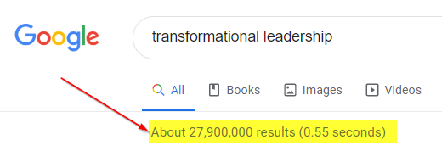
Google

Slide 18
Recent History
J.V. Downton 1973 coined the term in “Rebel Leadership”
J.M. George said Transformation leadership is “the creation of follower excitement and enthusiasm …stems from appraisal of followers’ authentic feelings.”
The Leadership Quarterly, 2000
Is this you or your manager?

Slide 19
Transformational leadership is:
…a theory of leadership where a leader works with teams to identify needed change, creating a vision to guide the change through inspiration, and executing the change in tandem with committed members of a group.
Involves greater ownership of work, connecting self to a project, and aligning self with the tasks.
https://en.wikipedia.org/

Slide 20
How measure Transformational Leadership?
Idealized influence
Inspirational Motivation
Intellectual Stimulation
Individualized consideration
www.mindgarden.com

Slide 21
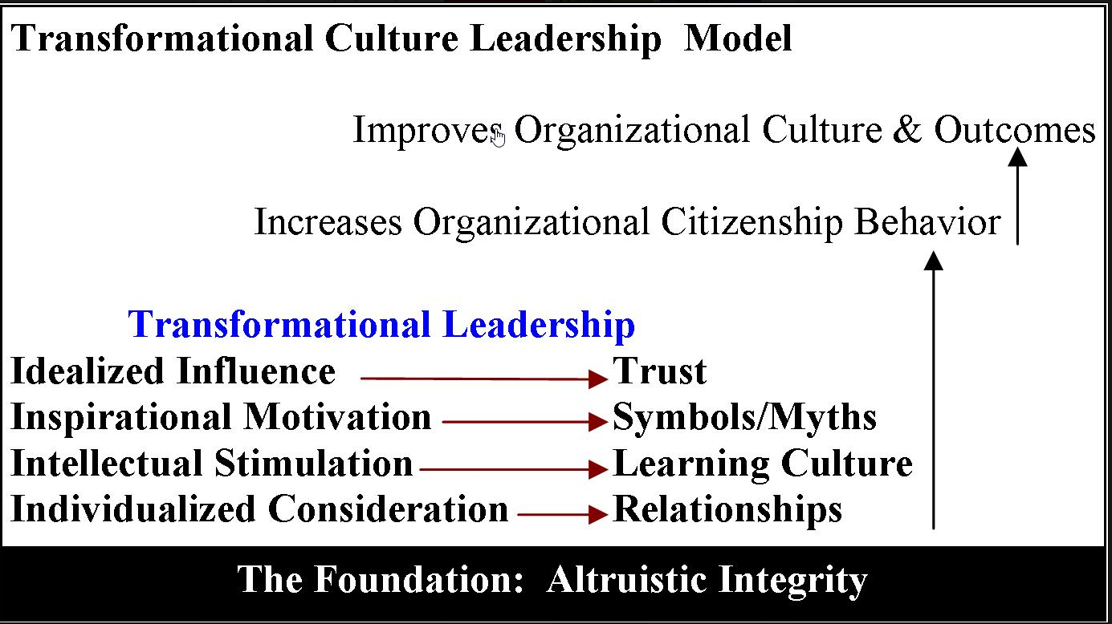

Slide 22
Transformational leadership is:
…a leadership style in which leaders encourage, inspire and motivate employees to innovate and create change that will help grow and shape the future success of the company.
Sarah White https://www.cio.com
Sarah also wrote an article on how to rewrite your resume to highlight your transformational leadership skills and experience.

Slide 23
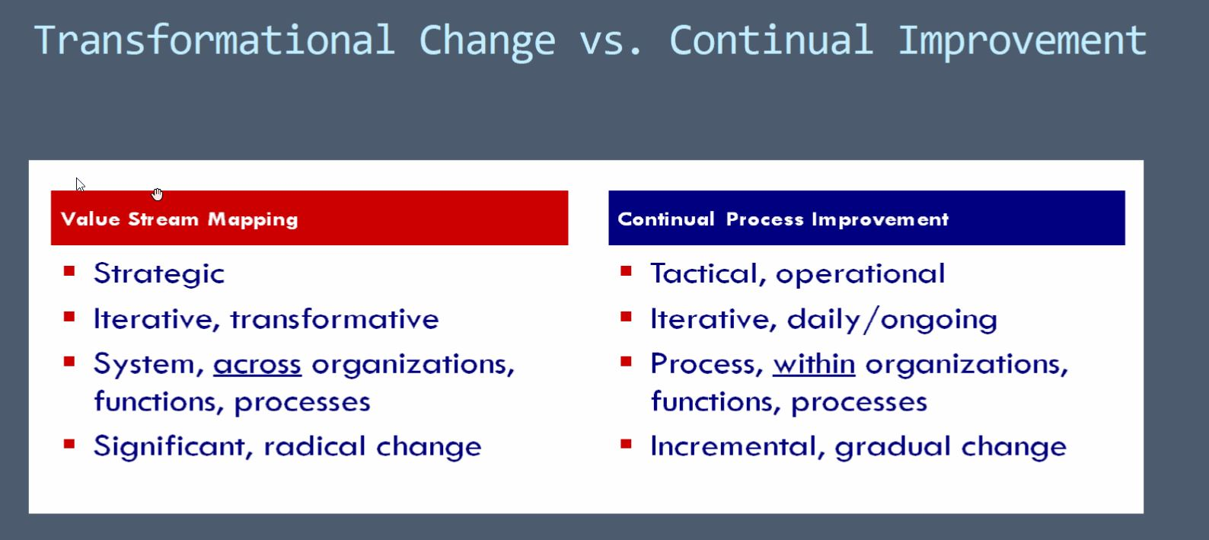
Bigger, radical changes Jeff Jensen www.itrainITLeaders.com

Slide 24
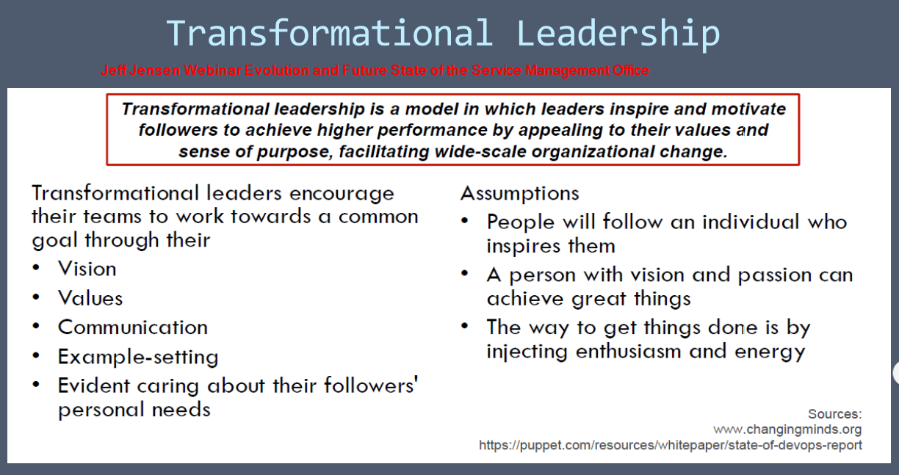

Slide 25
Results?

Slide 26
Over-Hyped & Over-Sold
…transformational leadership behavior …is currently the most widely accepted leadership paradigm”
MLQ Revisited, by H.J. Tejeda, 2001), quoted by Manon Deguire
Accepted in theory, but not common in practice.

Slide 27
70% of major transformations fail
1995 HBR published John Kotter article on
“Why Transformations Fail” (Hbr.org/1995/05)
70% were failing
2015 Follow up:
Harvard Business Review 2015: “70% of corporate major transformations still fail” (Hbr.org/2015/01 ) Why?

Slide 28

It’s really hard!!!!

Slide 29
It’s High Risk
Transformation is … “a portfolio of initiatives, which are interdependent or intersecting. …
The overall goal of transformation is not just to execute a defined change — but to reinvent the organization and discover a new or revised business model based on a vision for the future.
It’s much more unpredictable, iterative, and experimental. It entails much higher risk.”
hbr.org/2015/01/we-still-dont-know-the-difference-between-change-and-transformation

Slide 30
Joel’s Conclusion:
The odds of any of us being an inspirational world class transformational leader are poor.
But we can do this…
Make one transition at a time, one process at a time
Do constant process improvement
Deming Plan Do Check Act
Care for the people as well as the process
Keep the important stuff first
It’s called “Agile”

Slide 31
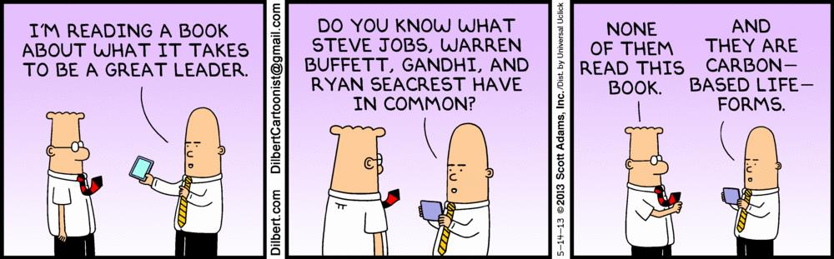
Books

Slide 32
The Phoenix Project
By Gene Kim, Kevin Behr, George Spafford

Slide 33
Phoenix: “Three Ways”
Work flows left to right from Dev to Ops to customer:
Don’t pass defects down, optimize at each step
Fast Feedback flows back at all stages of work:
Prevent problems from occurring again
Create culture of continual experimentation, innovation, and risk-taking.
High trust environment

Slide 34


I’m not a transformational leader
But if you need help with agile or software testing, let’s meet for coffee or lunch.
208-602 8478
www.linkedin.com/in/joelhenryrobinson/

